Slide 1
Linking Named Entity in Tweets with Knowledge Base via User Interest Modeling
Date : 2014/01/22
Author : Wei Shen, Jianyong Wang, Ping Luo, Min Wang
Source : KDD’13
Advisor : Jia-ling Koh
Speaker : Sheng-chi Chu

Slide 2
Outline
Introduction
Tweet entity linking
KAURI Framework
Experiment
Conclusion

Slide 3
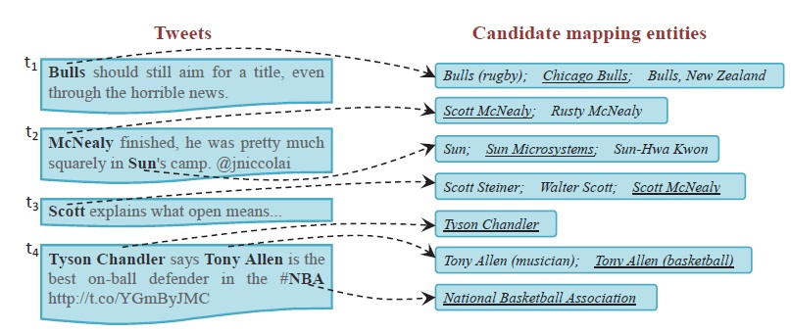
Introduction
The task to link the named entity mentions detected from tweets with the corresponding real world entities in the knowledge base is called tweet entity linking.
It is challenging due to the noisy ,short ,informal nature of tweets .
Previous methods:
Focus on linking entities in Web documents
Context Similarity
Topical coherence

Slide 4
Outline
Introduction
Tweet entity linking
KAURI Framework
Experiment
Conclusion

Slide 5
Tweet entity linking
input
output
Named entity metions in tweets are potentially ambiguous: the same textual name may refer to serveral different real world entities.
t1->Bulls 1.Bulls(rugby) 2.Chicago Bulls 3.Bulls,New Zealand (not Work well)
t3->Scott (not Work well)
t2->Sun: 1. Sun 2.Sun Microsystems 3.Sun-Hwa Kwon (Work well)
To slove the problem : it can increase the linking accuracy
Combine intra-tweet local information (Local)
with inter-tweet user interest information (KAURI)

Slide 6
Outline
Introduction
Tweet entity linking
KAURI Framework
Graph construction
Initial interest score estimation
User interest propagation algorithm
Experiment
Conclusion

Slide 7
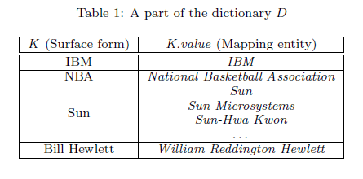
KAURI Framework
tweet
Named entity in tweet
Candidate mapping
entities
YAGO
Build Dictionary
Prior probability
Context simiarlity
Topical coherence
Graph construction
edge weight is defined as the topical relatedness
γ
α
β
Initial interest score estimation
Normalized
User interest propagation algorithm
final interest score
Notes:
highlight 強調

Slide 8
KAURI Framework
Assumption 1.
Each Twitter user has an underlying topic interest distribution over various topics of named entities.
Assumption 2.
If some named entity is mentioned by a user in his tweet, that user is likely to be interested in this named entity.
Assumption 3.
If one named entity is highly topically related to the entities that a user is interested in, that user is likely to be interested in this named entity as well.
Notes:
highlight 強調

Slide 9
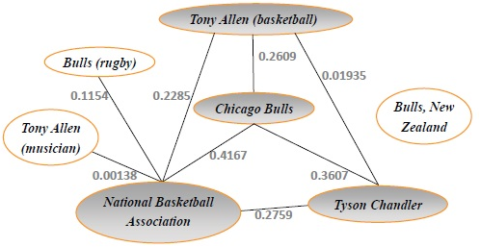
Graph construction
Example 1
To model the tweet entity linking problem into grapth-based interest propagation problem for each Twitter user .

Slide 10
Graph construction
Topical relatedness:
WP is set of all article in Wekipedia
U1 and U2 are the set of Wekipedia article that link to u1 and u2.
TR(u1 , u2) => 0.0 to 1.0

Slide 11

Topical relatedness
ex : Input : candidate entity are Wikipedia article (use WLM)
output : value[0-1]
|WP| = 40000,|U1| = 2000 , |U2| = 4000 , |U1∩U2| = 1000
TR(u1 , u2) = 1 - $\frac{log\frac{4000}{1000}}{log\frac{40000}{2000}}$ = 1- $\frac{log4}{log20}$ = 0.537
Wikipedia article link
d1
d2
d2
d5
d3
u1
u2

Slide 12
Initial interest score estimation
Intra-tweet local feature :
Prior probability
Context Similiarity
Topical coherence
Prior probability : in (2)
$r_{j}^{i}$_{,q} is set of candidate entities with index q in $R_{j}^{i}$ (t_{i}→M^{i} → $m_{j}^{i}$→ $R_{j}^{i}$)
Count($r_{j}^{i}$_{,q} ) is the number of link which point to entity $r_{j}^{i}$_{,q} and have the surface form $m_{j}^{i}$.
Context Similiarity : To mearure bag of word cosine similiarity of these two vectors weight
by TF – IDF .
Topical coherence : in (3)
M^{i} is set of named entity metions recongnized in each tweet t_{i.}
$e_{c}^{i}$ is the mapping entity for the entity mention $m_{j}^{i}$ (with index c in tweet t_{i}).

Slide 13
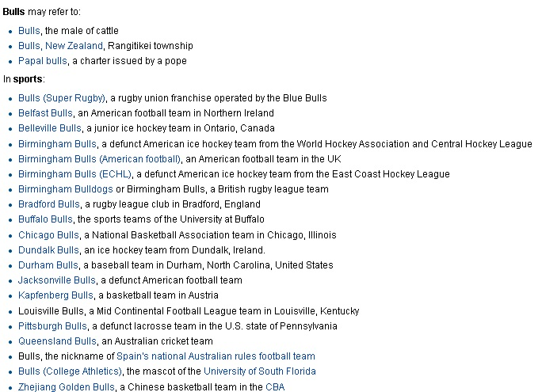
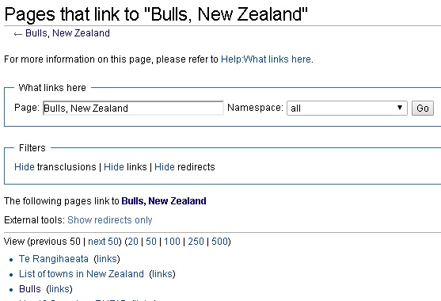
Prior probability
Prior probability suitably expresses the popularity of candidate mapping entity being mentioned given a surface form.(in decrease order)

Slide 14
Topical coherence
Ex: t_{i}∈T , |M⁴| = 3, |M¹| = 1
$$m_{1}^{1}$$
$$R_{1}^{1}$$
$$R_{1}^{4}$$
$$m_{1}^{4}$$
$$m_{2}^{4}$$
$$R_{2}^{4}$$
$$m_{3}^{4}$$
$$R_{3}^{4}$$
Tyson Chandler
Tony Allen(musician)
Tony Allen
NBA
Tyson Chandler
NBA

Slide 15
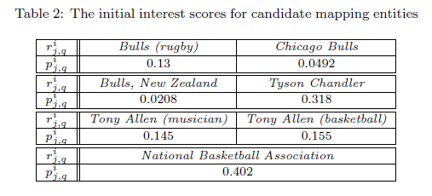
Initial interest score estimation
α + β + γ = 1
Initial interest score
Context similarity
Topical coherence in tweet
For tweet t₁ which lack sufficient intra-tweet context information to link entity mention”Bulls”.
For tweet t₄,the prior probability candidate entity :
Tony Allen(musician) > Tony Allen(backetball),
But initial interest scores is higher than Tony Allen(musician).

Slide 16
User interest propagation algorithm
A graph-based algorithm to propagate the interest score among different candidate mapping entities across tweets using the interdependence structure.
Normalize formula :
Interest propagation strength :
Final interest score :
Initalization : =
Then apply this formula iteratively until stabilizes within some threshold.
The Final interest score
The interest propagation strength matrix
Initial interest score
$$\overset{→}{s}$$
$$\overset{→}{p}$$
$$\overset{→}{s}$$

Slide 17
Outline
Introduction
Tweet entity linking
KAURI Framework
Experiment
Conclusion

Slide 18
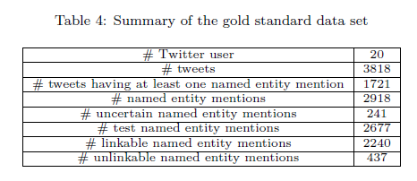
Experiment
Data set:
Tweet entity linking consists of detecting all the named entity mentions in all tweets and identifying their correponding mapping entities exist in YAGO.
The annotation task is very time consuming.
Set λ = 0.4 , baseline : LINDEN
Using 2-fold cross validation

Slide 19
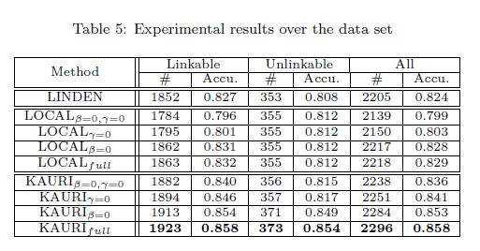
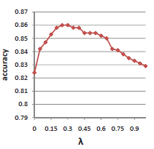
Experiment

Slide 20
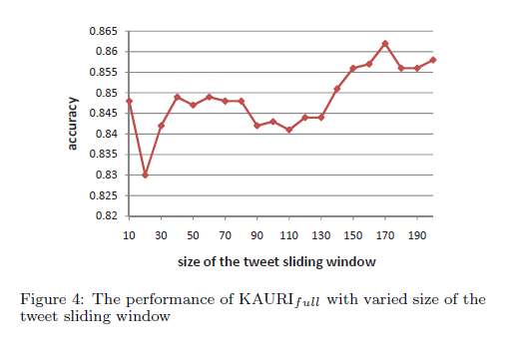
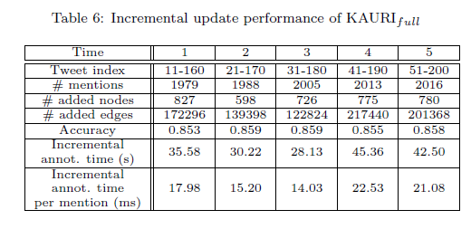
Experiment

Slide 21
Outline
Introduction
Topic Extraction
Opinion Summarization
Experiment
Conclusion

Slide 22
Conclusion
Proposed KAURI, a graph-based framework that combined intra-tweet local information with the inter-tweet user interest information.
KAURI achieves high performance in term of accuracy and efficiency ,and scales well to tweet stream.

